Slide 1
Introduction to AI – Deep Learning
Philip Mortimer

Slide 2
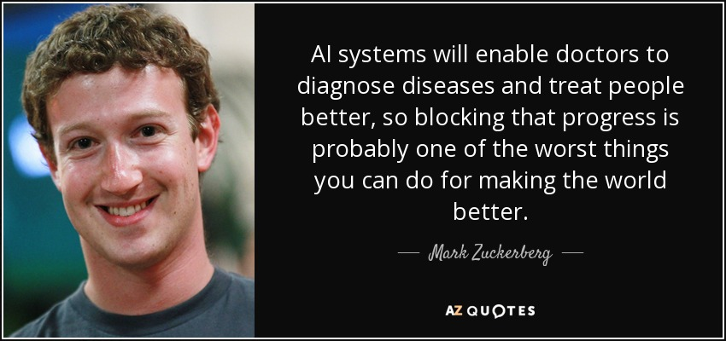

Slide 3
Recap
Discussed perceptrons – units that take a weighted sum of inputs and a bias to produce a value.
These units can be combined to draw a straight line that categorises a dataset
Through the use of a non-linear activation function, these units can draw any line (and thus solve any classification problem).
Combining these units creates a neural network – which forms the basis of modern ML techniques
We discussed how we can use labelled datasets to measure how far off the correct value an AI is. We defined this as the loss function. This is sometimes also called the cost function.

Slide 4
Recap
Using clever maths, we can calculate the gradient of the loss function with each individual weight and bias of a neural network.
If we travel a small distance in the opposite direction of this gradient, we will go in the direction that reduces the loss most quickly.
If we compute this gradient for every weight and bias and alter each weight and bias by a small amount in the direction of the calculated gradient, we will reduce our loss over time.
The size of the step is normally small and is called the learning rate.
In supervised learning, we have a large dataset (say of images of handwritten digits). We split this set into a training set, testing set and validation set.

Slide 5
Recap
In order to calculate the derivative of the loss with respect to the test data, we must use a batch of images in order to obtain an accurate estimate of the true loss. However, if the batch size is too large, the network will take too much time to train
We also need to define a neural network architecture. This involves defining the sizes of the input and output layers. Additionally, we need to decide how many neurons should be present for each hidden layer of the network
We also discussed how we use epochs to decide how long the network should train for.

Slide 6
Example
Supervised learning is most definitely the most commonly used AI technique
It is also very tricky to grasp
To reinforce some of the concepts, let’s train a neural network to classify tumours as either malignant (cancerous) or benign (non-cancerous)
We will use a dataset of ~3,500 images
Each of these images is 224 * 224 pixels wide and in colour. This means that each pixel has three values that denote it’s rgb components. Each image thus can be represented using 150, 000 input neurons.

Slide 7
Cancer AI
That’s a lot of parameters. In practice, we would probably employ more advanced techniques to reduce this.
For example, we may only choose to look at the image as grayscale.
However, for our example, let’s not do this.
For our output, we know that the image is labelled as either benign or malignant.
Similar to our MNIST example, let’s use two output nodes. Output node #1 can be interpreted as “the probability that the tumour is benign”. Similarly, output node #2 is “the probability that the tumour is malignant”.
For our diagnosis model, we’ll simply choose the most probable one as our diagnosis.

Slide 8
Cancer AI
This is a much more complicated problem than MNIST and therefore, it stands to reason that we will need a bigger network.
Let’s use five hidden layers with the following sizes: 170, 800, 800, 500, 100.
This value has been obtained through a combination of intuition and trial and error.
This gives us the following architecture:
150,528 – 170 – 800 – 800 – 500 – 100 – 2
That’s a total of 26,818,332 weights and biases to be updated. This is a large network and will be expensive to train

Slide 9
Cancer AI
As the network is so large, we will need a large enough batch size to give a full overview of the network’s loss
However, the batch size should be fairly small in order to ensure the network trains over a reasonable time frame. Let’s choose a batch of 64 images
For the learning rate, we will use 0.001. This often proves to be a good value
We will also use an optimiser called Adam

Slide 10
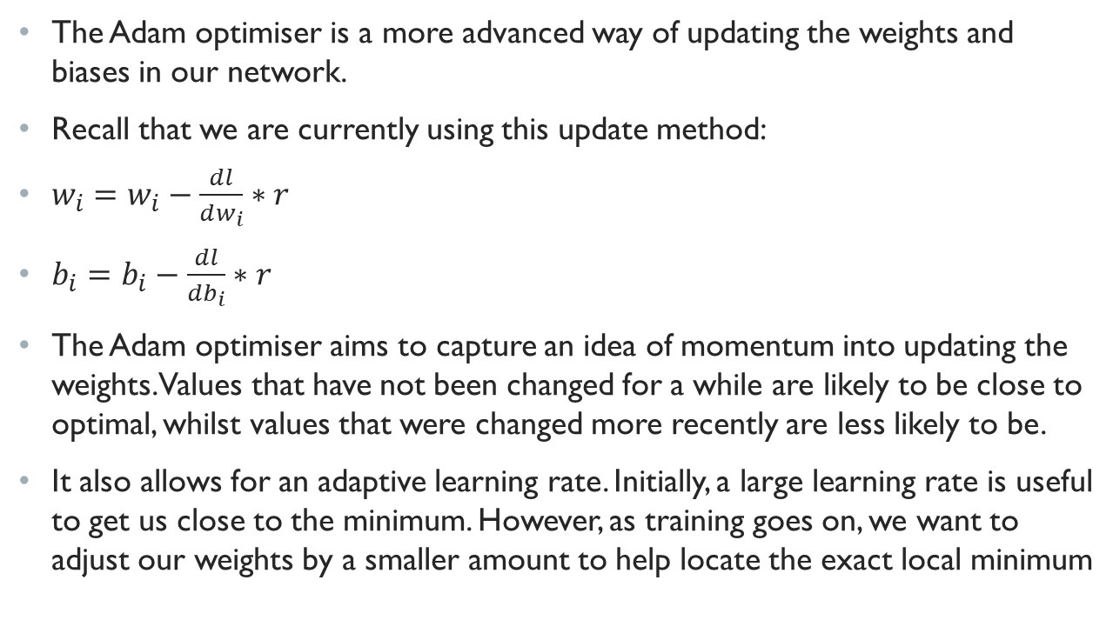
Adam optimiser
The Adam optimiser is a more advanced way of updating the weights and biases in our network.
Recall that we are currently using this update method:
$w_{i}=w_{i}−\frac{dl}{dw_{i}}∗r$
$b_{i}=b_{i}−\frac{dl}{db_{i}}∗r$
The Adam optimiser aims to capture an idea of momentum into updating the weights. Values that have not been changed for a while are likely to be close to optimal, whilst values that were changed more recently are less likely to be.
It also allows for an adaptive learning rate. Initially, a large learning rate is useful to get us close to the minimum. However, as training goes on, we want to adjust our weights by a smaller amount to help locate the exact local minimum

Slide 11
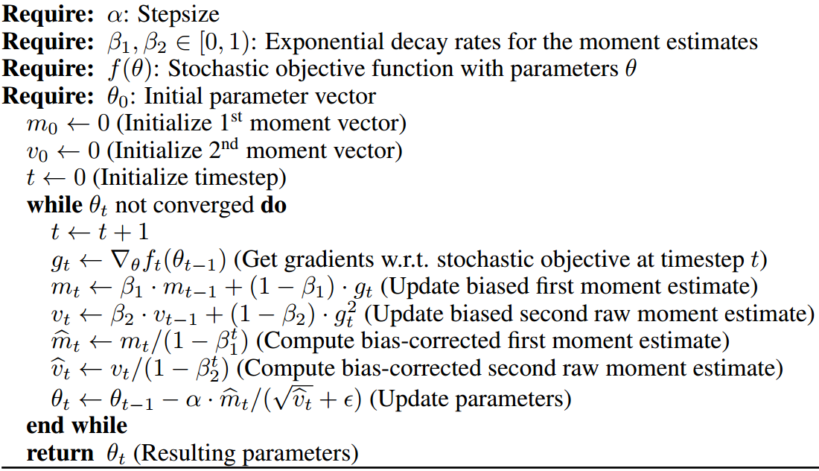
Adam
The maths is complicated (and I don’t expect anyone to understand it), but I thought I’d include it for completeness
All you need to know is that is generally a much more effective way to train a model

Slide 12
Cancer Ai
We also need to decide what activation functions to use in our neural network.
For our cancer AI, I have elected to use the reLu function in all layers bar the output layer. For the output layer, I will use the softmax function.
reLu is used as it has been proven to be effective for general use. It is also really cheap to use in calculations when compared to sigmoid. This is because reLu uses a simple if statement, whilst the sigmoid function uses a number of exponential functions

Slide 13
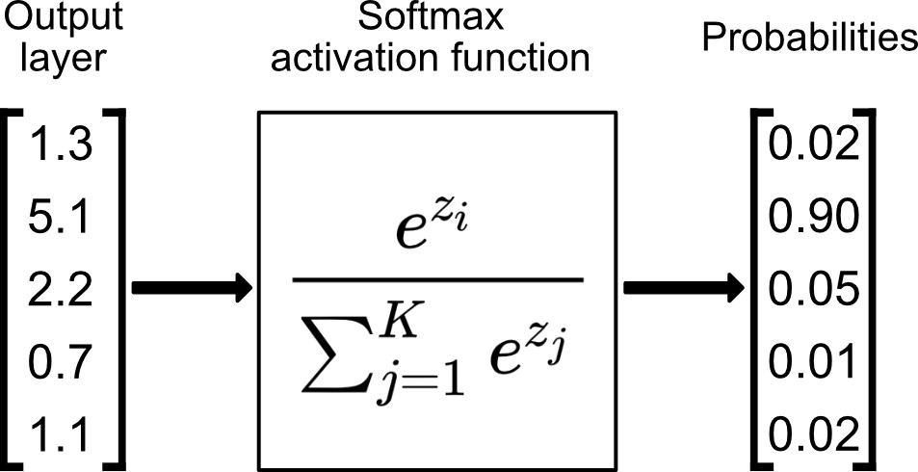
SoftMax
The SoftMax function is often used in classification tasks (and in conjunction with the sigmoid function)
It takes in a vector as an argument and produces a vector as an output. The key property of this vector is that the sum of the output elements is 1. This is very useful as we often interpret our model outputs as probabilities.
When using a softmax activation function, the categorical cross entropy loss function is often used.

Slide 14
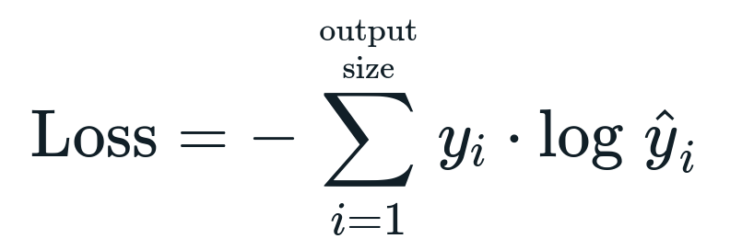
Categorical Cross Entropy
Like MSE, this is an example of a loss function
The idea is that for one hot encoded outputs, the loss is only judged for the node that should have the value of one.
Again, this is a complicated formula, so no need to fully understand it

Slide 15
Cancer AI
As this problem is rather complex, I will give the network lots of training time. I will train the network for 30 epochs
This gives us the following parameters:
Learning rate = 0.001
Optimiser = Adam
Batch size = 64
Epochs = 30
Architecture = 150,528 – 170 – 800 – 800 – 500 – 100 – 2
Activation for non-output layers = reLu
Activation for output layer = SoftMax
Loss function = categorical cross entropy

Slide 16
Cancer AI
This network took many hours to train on my laptop using my machine learning library.
Typically neural networks are trained using specialist software and on very powerful computers that have graphics cards.
However, after training the model overnight, I did produce a neural network to address the task.
You can find my training code and model here: https://github.com/philipmortimer/AI-Course/tree/main/Programs/Part%205/Tumour-Classification-Using-Machine-Learning
To open the model, simply open the “.jar” file

Slide 17
Cancer AI
Our AI is slow and took a long time to train
However, it does outperform dermatologists at cancer diagnosis
This clearly demonstrates the power of machine learning models
However, unlike the MNIST example, our neural network is far less confident when making predictions
There are a few clear flaws in our network.
Firstly, the input space is too large for the dataset
We should reduce this through compression and Gray scaling

Slide 18
Cancer AI
Our neural network architecture is referred to as a feedforward neural network
Using this type of architecture for images is not entirely appropriate.
Normally, each input node should represent a consistent metric
In our case, a given input node represents a single pixel
However, pixels don’t consistently represent something
This is because images of tumours aren’t all perfectly centred
We would like a neural network that is able to extract meaningful features and use these to produce an AI that is less dependent on perfectly centred images

Slide 19
Overfitting
Additionally, neural networks often face an issue when it comes to training on large datasets
When training initially, our network learns general features about data points. For example, it may learn that tumours that are red are more likely to be cancerous
However, neural networks often have more parameters than strictly needed.
So once they have learned all the features that can be extracted from a network, they will start to use their remaining capacity to memorise data points from the training set. This leads to the training loss continuing to decrease
However, this also makes the model less accurate when being deployed on real world data (when this memorisation is of no help to it)
This is called overfitting

Slide 20
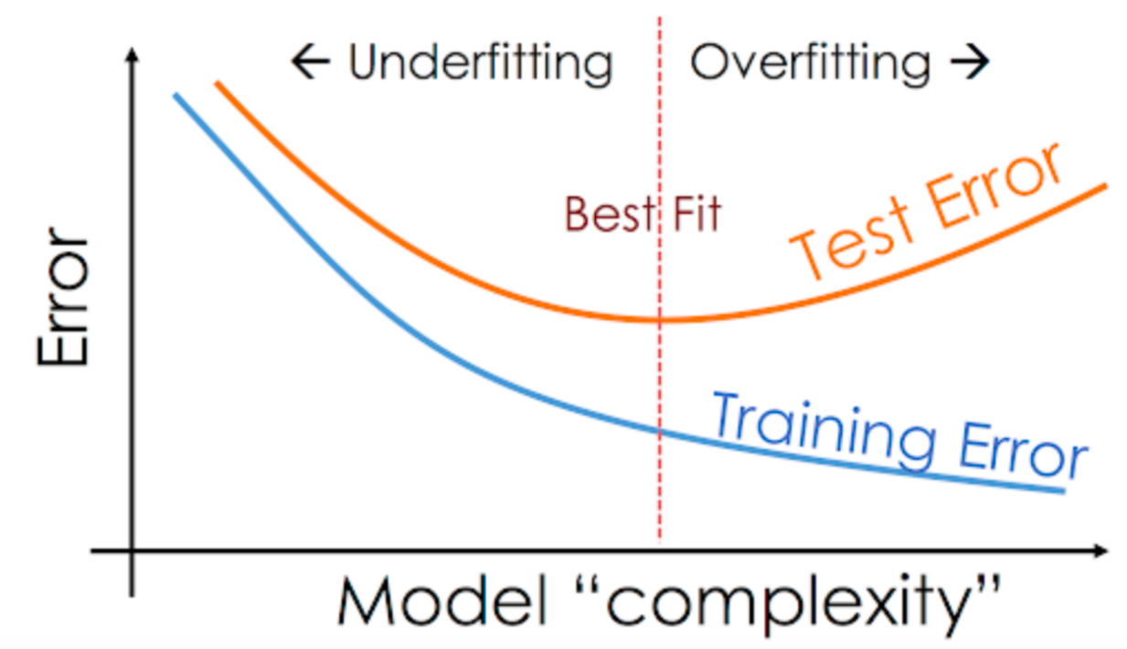
Overfitting
When the test loss stops decreasing, we know that our model has stopped learning meaningfully
We should stop training at this point

Slide 21
Regularisation
To prevent overfitting, regularisation techniques are used to reduce the complexity of models
There are three commonly used techniques: L1, L2 and dropout regularisation
L1 and L2 are rather mathematically complicated but both essentially involve reducing the value of weights over time. This leads to some neurons being negligible to the network output and thus reduces complexity

Slide 22
Dropout regularisation
The idea behind drop out regularisation is that for each batch, a percentage of all neurons are deactivated (i.e. always return 0).
This forces the network to use the whole neural network infrastructure when producing an output, instead of relying on one specific output path
This prevents memorisation as it is much harder to memorise paths when only a random subset of the network functions at a given point in time

Slide 23
Convolutional Neural Networks
A Convolutional Neural Network (CNN) is a very common neural network structure.
CNN’s are more commonly used than ANN’s (what we’ve looked at previously) and have several advantages over them
They extract high level features from datapoints and thus are rotationalyl and positionally invariant. In short, they “learn” more intelligently
CNN’s are commonly used on images

Slide 24
CNN
CNN’s combine artificial neural networks (ANN’s) like we’ve previously discussed with an algorithm that extracts high level features from very complicated data.
This is very useful for image classification, as images may have millions of individual pixels. By extracting high level features (e.g. edges, gradients etc.), we are able to train AI on large datasets of very large images. This is just not possible with ANN’s.
As CNN’s learn from high level features, they do not require all data items to follow the same format.
In the case of tumour recognition, a CNN would mean that tumours don’t have to be right in the centre of the frame.
In short CNN = feature extraction + Neural Network
We already know exactly how the neural network functions

Slide 25
Feature Extraction
Typically CNN uses a combination of convolutional layers and pooling layers
Convolutional layers use a sliding window to reduce the dimensionality of an image. This sliding window uses complicated matrix calculations to extract features from an image

Slide 26
Credit: https://towardsdatascience.com/a-comprehensive-guide-to-convolutional-neural-networks-the-eli5-way-3bd2b1164a53

Slide 27
The idea here is we have a kernel matrix with the following values:
1 0 1
0 1 0
1 0 1
This matrix is multiplied by the values in our window to produce our smaller convolved feature matrix
This is a good practical way to reduce the data size whilst still maintaining the important high level features
Credit: https://towardsdatascience.com/a-comprehensive-guide-to-convolutional-neural-networks-the-eli5-way-3bd2b1164a53

Slide 28
Max Pooling
Following our convolutional layer, we often still have a very large output space.
In order to reduce this further we use a technique known as max pooling
The idea is similar; we have a small sliding window that looks at a subset of the convolved features. It takes the maximum value of each of those pixels as it’s new value
This turns out to be an effective way to reduce dimensionality whilst retaining the important features

Slide 29
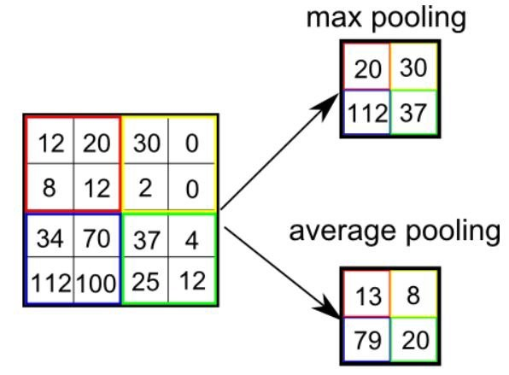
Credit: https://towardsdatascience.com/a-comprehensive-guide-to-convolutional-neural-networks-the-eli5-way-3bd2b1164a53

Slide 30
CNN
Typically CNN’s will use Convolutional layers and pooling layers a number of different times. The final output of the system will be attached to a fully connected neural network to learn from the extracted features

Slide 31
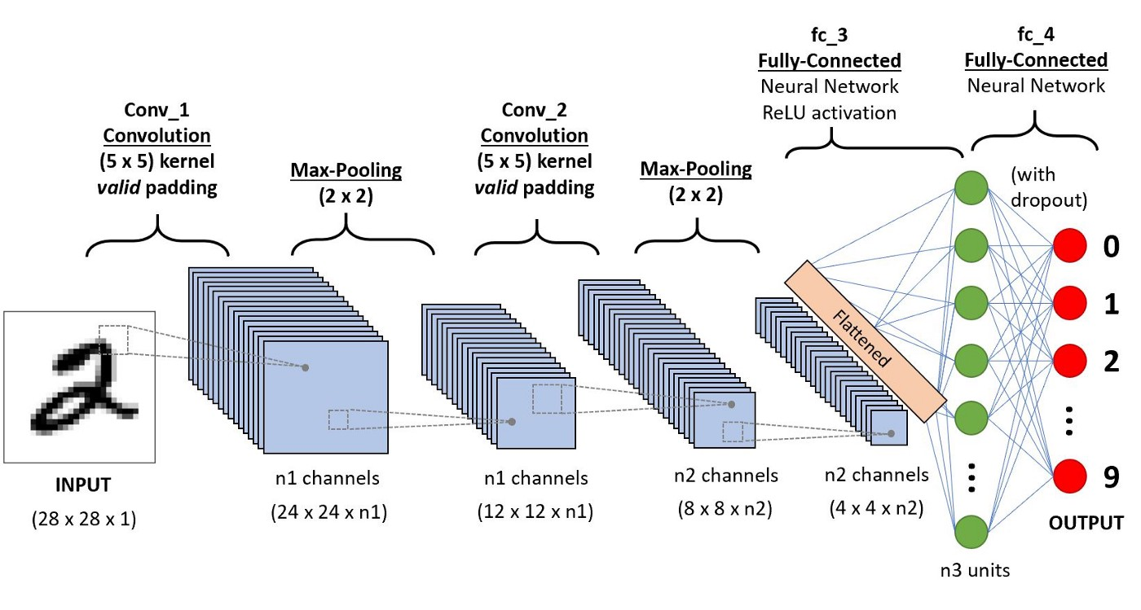
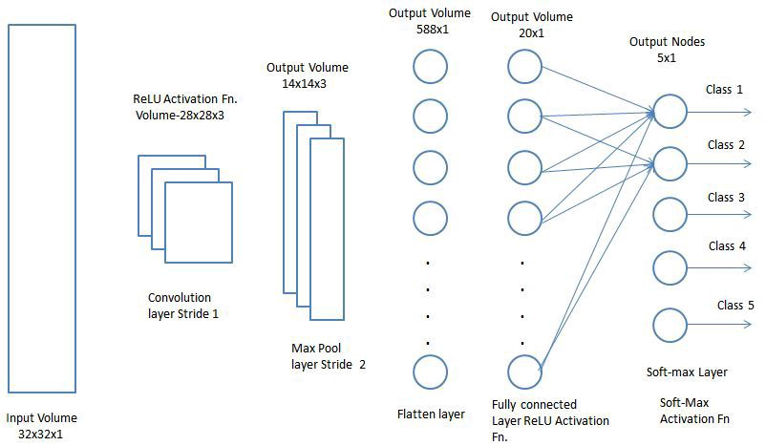

Credit: https://towardsdatascience.com/a-comprehensive-guide-to-convolutional-neural-networks-the-eli5-way-3bd2b1164a53

Slide 32
CNN
It turns out CNN’s are the most versatile neural network architecture choice and perform very well on a range of problems
CNN’s are especially powerful in Computer vision domains (e.g. image recognition)
There are a whole range of other architecture types. However, CNN and ANN’s are by far the two most common ones.
They can be applied to countless problems.

Slide 33
RNN
I will also briefly mention that current research often focus on recurrent neural networks (RNN).
These use long short term memory networks (LSTM).
The maths is very complicated.
CNN and ANN take a single datapoint and produces a result
LSTM’s can process a series of datapoints, allowing them to be used in temporal tasks more effectively
However, any more detail is far beyond the scope of this course.
You should simply be aware that they exist and are good for processing series of data (often along the time axis). For example, meteorological readings may be used by an LSTM to produce a weather forecast.

Slide 34
Libraries
In order to train neural networks, seriously optimised and low level code is needed to train them in a reasonable time window
Many companies have private ML libraries that have been highly tested and optimised
However, the vast majority of programmers use a small range of publicly available and free to use libraries.
These libraries are open source and can be used for all purposes (including commercial) free of charge

Slide 35


Libraries
Most machine learning projects tend to use “TensorFlow” or “PyTorch”. These are libraries which can be interacted with through the python programming language.
Model creation and training can be achieved with just a few lines of code
These libraries have been written by a large team of programmers. This means all functionality is very well tested and that the implementation is efficient
Additionally, there is detailed documentation available in order to easily use it
As these libraries are so widely used, there’s a large community that can potentially offer support should any issues be encountered

Slide 36
TensorFlow
TensorFlow is the most used ML framework in the world
Python is used to implement the API. However, the actual implementation is extremely fast C code
TensorFlow can be installed here: https://www.tensorflow.org/install/pip
Note that a working installation of Python (amongst other things) may be required depending on your system.

Slide 37
TensorFlow
To demonstrate TensorFlow, I will use it to solve the MNIST problem we solved earlier. I’ll first do this using an ANN.
The script is loosely derived from this: https://github.com/tensorflow/docs/blob/master/site/en/tutorials/quickstart/beginner.ipynb
The script can be found here (in “annMnist.py”): https://github.com/philipmortimer/AI-Course/tree/main/Programs/Part%205/TFMnist
Recommended IDE: “PyCharm”

Slide 38
TensorFlow
Let’s look at code!

Slide 39
Cnn
Next, let’s make a CNN for the MNIST task.
Code can be found here (at “cnnMnist.py”): https://github.com/philipmortimer/AI-Course/tree/main/Programs/Part%205/TFMnist
This model is much bigger, but achieves a remarkable performance of ~99.3% after 5 epochs
Lets look at the code!

Slide 40
Summary
We reinforced our understanding of training of artificial neural networks by demonstrating how we can train one to diagnose cancer.
We discussed the adam optimiser
Softmax activation
Categorical cross entropy loss
We discussed CNN as a common ML model that uses feature extraction to improve on the ANN model.
We looked at popular deep learning library TensorFlow and made our own models using a CNN and ANN to recognise handwritten digits.

Slide 41

Questions

Slide 42
Further Reading
CNN - https://towardsdatascience.com/a-comprehensive-guide-to-convolutional-neural-networks-the-eli5-way-3bd2b1164a53
TensorFlow tutorials - https://www.tensorflow.org/tutorials

